Slide 1
Yummy-Bites
Team Details → Diksha – 2210090282
Divij – 2210090292
Diya – 2210990300
Yashika – 2210990977
Under the supervision
of
Mr Vikas Patel
Ms Parul
Name of Department/School
Chitkara University, Punjab

Slide 2
Introduction
The website makes it super easy for you to order the food you love .
You can order food from a variety of sources, including restaurants, cafes and online food delivery services
we'll bring it right to your door, so you don't even have to leave your house!

Slide 3
PROBLEM STATEMENT
Suppose you're hungry and want food delivered to your doorstep. But finding the right place, making sure the food arrives hot and tasty
That's where online food delivery websites come in. They're supposed to make it easy to order food from your favorite restaurants. But sometimes, it's not as smooth as we'd like.
So, the challenge is to create a website that's super easy to use, makes sure your food arrives on time and offers lots of tasty options.
By solving these problems, we can make hungry customers happy and keep them coming back for more!

Slide 4
Motivation Of Research
The primary motivation is to provide customers with a convenient way to access a wide range of food options from various restaurants without the need to physically visit each establishment.
You can order food from the comfort of your own home, avoiding the hassle of cooking or going out to eat.
It's all about giving customers the convenience of ordering food online, making sure they have lots of options to choose from, and helping restaurants reach more customers and grow their business using the internet.

Slide 5
Tools & Technologies
In this we have used :
HTML5 →It is used for creating and structuring the content of web pages
CSS → It is used to style and layout webpage.
JAVASCRIPT → It is used to make webpage interactive(had used reactjs library here).

Slide 6
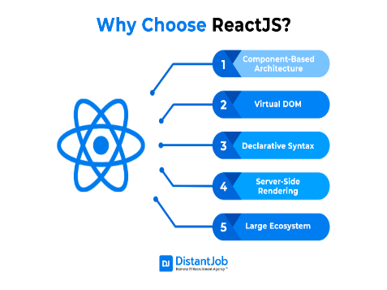
Why ReactJS Library?
Before the invention of React.js, when performing an action like clicking a button, the entire page would often refresh, causing the entire DOM tree to re-render. With the introduction of the React.js library, this issue was addressed, and now, re-renders occur only when necessary.

Slide 7
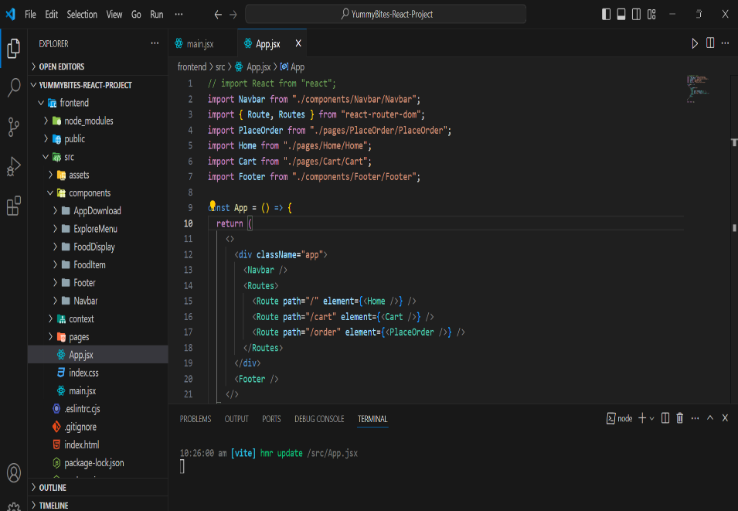
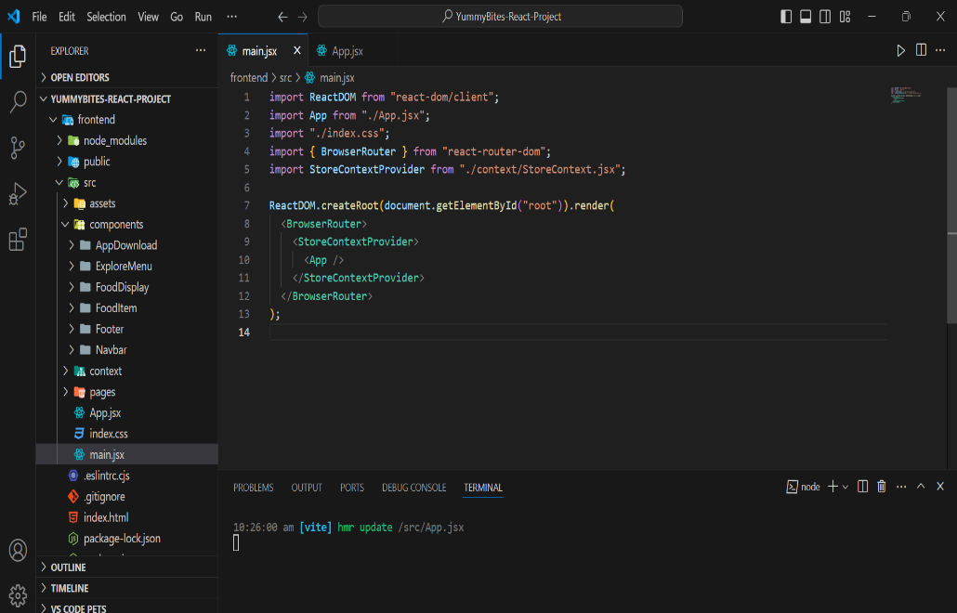
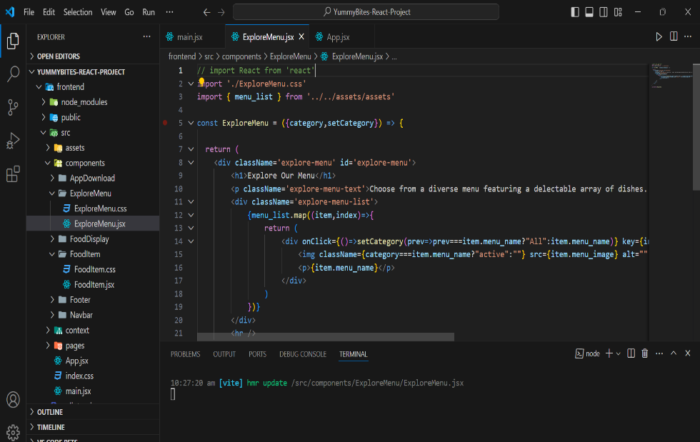
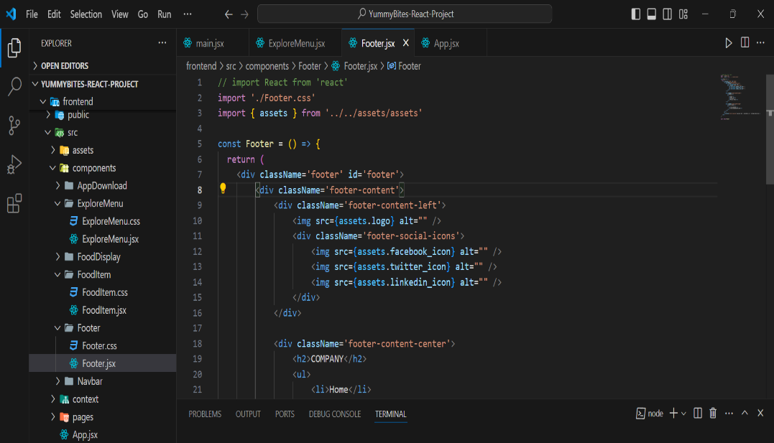
Code Snippets

Slide 8
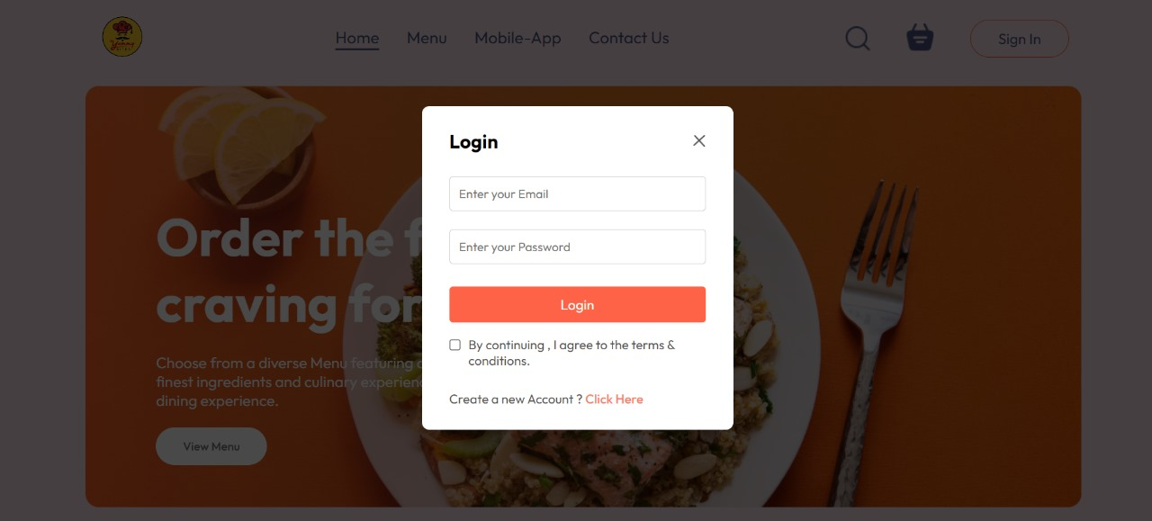
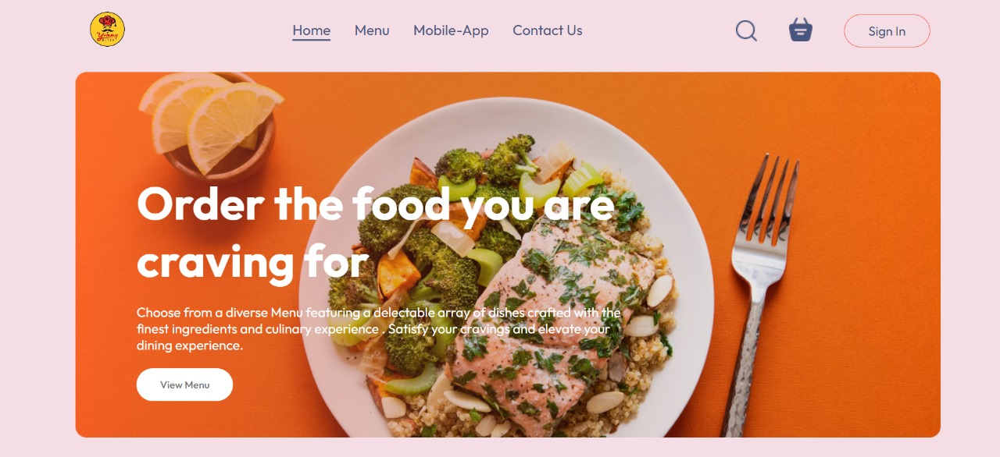
Project Snapshots

Slide 9
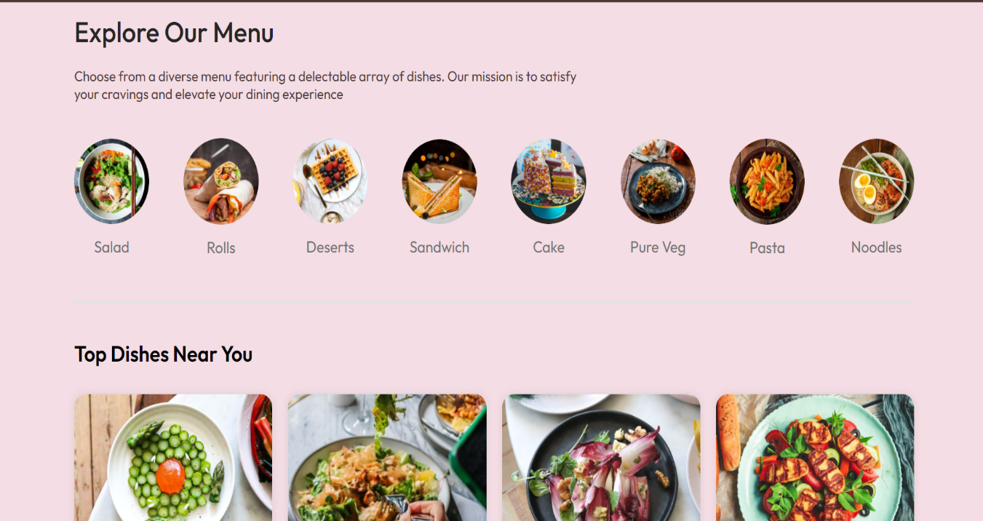
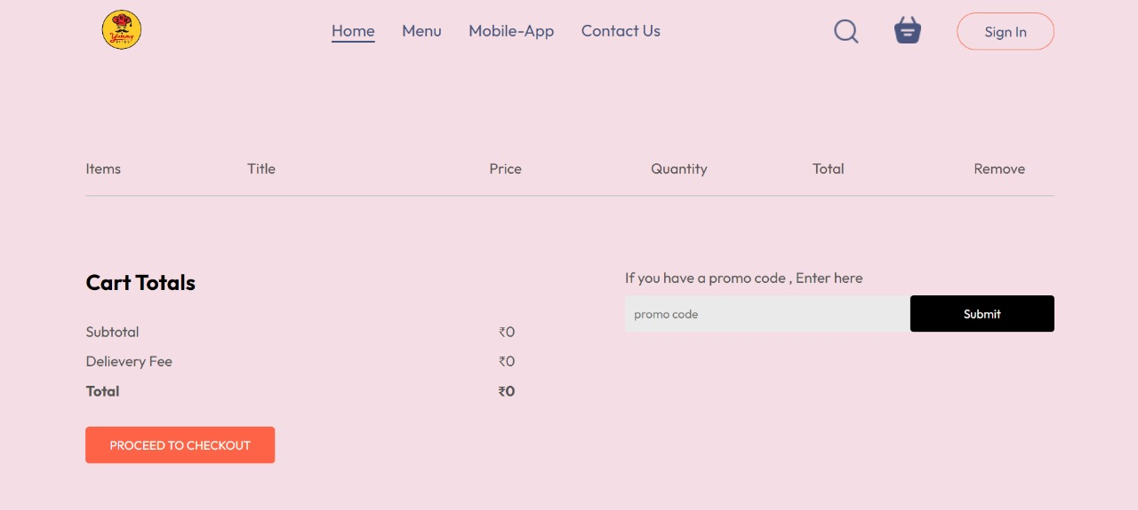

Slide 10
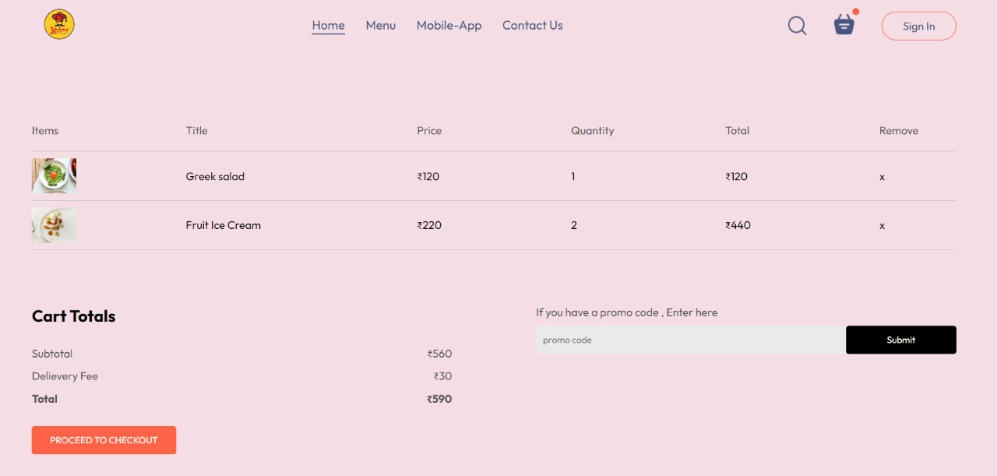
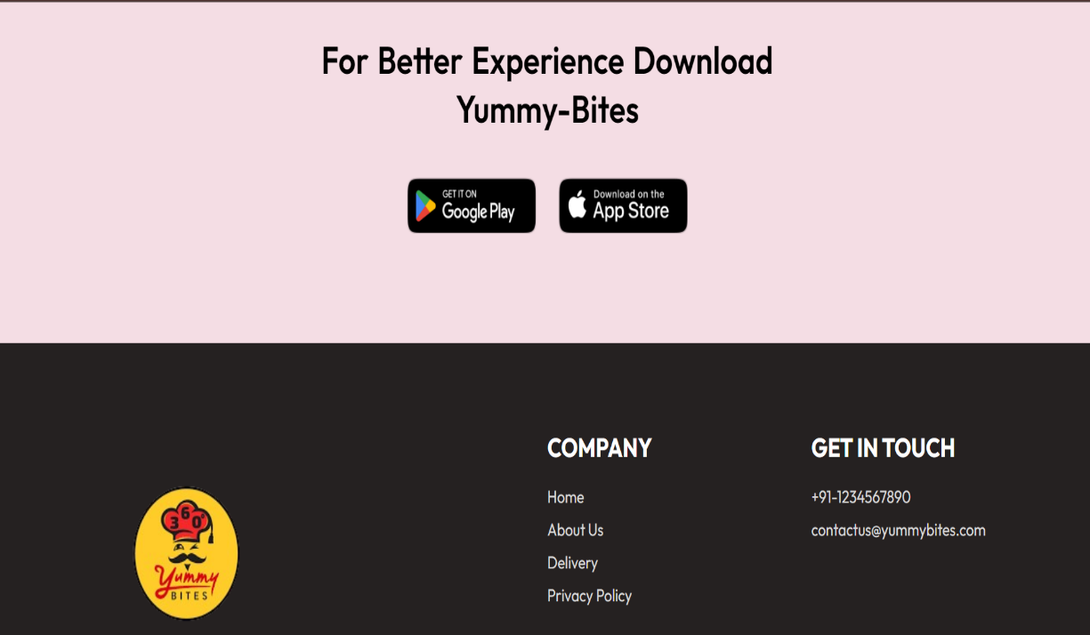
Continue..

Slide 11
Conclusion
Simple Ordering Process: The ordering process is easy to follow.
Responsive Design: The website is responsive and optimized for various devices, including smartphones, tablets, and desktop computers. This ensures that users can access the platform seamlessly from any device, enhancing their overall experience.
Transparent information: Providing clear and honest information about price.

Slide 12
References
We have taken reference from :
W3Schools → www.w3schools.com
Geeksforgeeks -> www.geeksforgeeks.com
YouTube: →https://www.youtube.com/watch?v=Xe8CkYZvCig&t=4237s
→https://www.youtube.com/playlist?list=PLu0W_9lII9agx66oZnT6IyhcMIbUMNMdt

Slide 13


